Slide 1
C Language Programming
for the 8051
Prof. Cherrice Traver
EE/CS-152: Microprocessors and Microcontrollers

Slide 2
Overview
C for microcontrollers
  Review of C basics
  Compilation flow for SiLabs IDE
  C extensions
  In-line assembly
  Interfacing with C
Examples
Arrays and Pointers
I/O Circuitry
Functions and Header Files
Multitasking and multithreading
Prof. Cherrice Traver
EE/CS-152: Microprocessors and Microcontrollers

Slide 3
C for Microcontrollers
Of higher level languages, C is the closest to assembly languages
  bit manipulation instructions
  pointers (indirect addressing)
Most microcontrollers have available C compilers
Writing in C simplifies code development for large projects.
Prof. Cherrice Traver
EE/CS-152: Microprocessors and Microcontrollers

Slide 4
Available C Compilers
Keil – integrated with the IDE we have been using for labs.
Reads51 – available on web site (http://www.rigelcorp.com/reads51.htm)
Freeware: SDCC - Small Device C Compiler (http://sdcc.sourceforge.net/)
Other freeware versions …
Prof. Cherrice Traver
EE/CS-152: Microprocessors and Microcontrollers

Slide 5
Compilation Process (Keil)
program.c
no SRC option
compile
program.LST
program.OBJ
build/make
program.M51
Prof. Cherrice Traver
EE/CS-152: Microprocessors and Microcontrollers

Slide 6
Modular Programming
Like most high level languages, C is a modular programming language (but NOT an object oriented language)
Each task can be encapsulated as a function.
Entire program is encapsulated in “main” function.
Prof. Cherrice Traver
EE/CS-152: Microprocessors and Microcontrollers

Slide 7
Basic C Program Structure
Compiler directives and include files
Declarations of global variables and constants
Declaration of functions
Main function
Sub-functions
Interrupt service routines
Example: blinky.c
Prof. Cherrice Traver
EE/CS-152: Microprocessors and Microcontrollers

Slide 8
Back to C Basics
All C programs consists of:
  Variables
  Functions (one must be “main”)
    Statements
To define the SFRs as variables:
  #include <c8051F020.h>
Prof. Cherrice Traver
EE/CS-152: Microprocessors and Microcontrollers

Slide 9
Variables
All variables must be declared at top of program, before the first statement.
Declaration includes type and list of variables.
  Example: void main (void) {
  int var, tmp;
Types:
  int (16-bits in our compiler)
  char (8-bits)
  short (16-bits)
  long (32-bits)
  sbit (1-bit)
  others that we will discuss later
must go HERE!
not standard C – an 8051 extension
Prof. Cherrice Traver
EE/CS-152: Microprocessors and Microcontrollers

Slide 10
Variables
The following variable types can be signed or unsigned:
signed char (8 bits) –128 to +127
signed short (16 bits) –32768 to +32767
signed int (16 bits) –32768 to +32767
signed long (32 bits) –2147483648 to +2147483648
unsigned char (8 bits) 0 to + 255
unsigned short (16 bits) 0 to + 65535
unsigned int (16 bits) 0 to + 65535
unsigned long (32 bits) 0 to + 4294967295
NOTE: Default is signed – it is best to specify.
Prof. Cherrice Traver
EE/CS-152: Microprocessors and Microcontrollers

Slide 11
Statements
Assignment statement:
  variable = constant or expression or variable
  examples: upper = 60;
  I = I + 5;
  J = I;
Prof. Cherrice Traver
EE/CS-152: Microprocessors and Microcontrollers

Slide 12
Operators
Arithmetic: +, -, *, /
Relational comparisons: >, >=, <, <=
Equality comparisons: ==, !=
Logical operators: && (and), || (or)
Increment and decrement: ++, --
Example:
  if (x != y) && (c == b)
  {
  a=c + d*b;
  a++;
  }
Prof. Cherrice Traver
EE/CS-152: Microprocessors and Microcontrollers

Slide 13
Example – Adder program
(add 2 16-bit numbers)
$INCLUDE (C8051F020.inc)
XL equ 0x78
XH equ 0x79
YL equ 0x7A
YH equ 0x7B
cseg at 0
ljmp Main
cseg at 100h
; Disable watchdog timer
Main: mov 0xFF, #0DEh
mov 0xFF, #0ADh
mov a, XL
add a, YL
mov XL, a mov a, XH
addc a, YH
mov XH, a
nop
end
#include <c8051f020.h>
void main (void) {
int x, y, z; //16-bit variables
// disable watchdog timer
WDTCN = 0xde;
WDTCN = 0xad;
z = x + y;
}
The C version
The assembly version
Prof. Cherrice Traver
EE/CS-152: Microprocessors and Microcontrollers

Slide 14
Compilation Process (Keil)
Use the #pragma CODE compiler directive to get assembly code generated in SRC file.
adder.c
compile
look here in RAM
when debugging
adder.SRC
adder.OBJ
assemble
build/make
adder.M51
Map file shows where variables are stored. One map file is generated per project.
Symbol Table in M51 file:
------ DO
D:0008H SYMBOL x
D:000AH SYMBOL y
D:000CH SYMBOL z
------- ENDDO
Prof. Cherrice Traver
EE/CS-152: Microprocessors and Microcontrollers

Slide 15
adder.SRC
x?040: DS 2
y?041: DS 2
z?042: DS 2
main:
; SOURCE LINE # 12
; int x, y, z;
; WDTCN = 0xde; // disable watchdog timer
; SOURCE LINE # 14
MOV WDTCN,#0DEH
; WDTCN = 0xad;
; SOURCE LINE # 15
MOV WDTCN,#0ADH
; z = x + y;
; SOURCE LINE # 17
MOV A,x?040+01H
ADD A,y?041+01H
MOV z?042+01H,A
MOV A,x?040
ADDC A,y?041
MOV z?042,A
; } ; SOURCE LINE # 18
RET
; END OF main
END
Prof. Cherrice Traver
EE/CS-152: Microprocessors and Microcontrollers

Slide 16
Bitwise Logic Instructions
AND
OR
XOR
left shift
right shift
1’s complement
Examples:
&
|
^
<<
>>
~
n = n & 0xF0;
n = n & (0xFF << 4)
n = n & ~(0xFF >> 4)
Prof. Cherrice Traver
EE/CS-152: Microprocessors and Microcontrollers

Slide 17
Example – Logic in Assembly and C
Main:
mov WDTCN, #0DEh
mov WDTCN, #0ADh
xrl a, #0xF0 ; invert bits 7-4
orl a, #0x0C ; set bits 3-2
anl a, #0xFC ; reset bits 1-0
mov P0, a ; send to port0
void main (void) {
char x;
WDTCN = 0xDE;
WDTCN = 0xAD;
x = x ^ 0xF0;
x = x | 0x0C;
x = x & 0xFC;
P0 = x;
}
Prof. Cherrice Traver
EE/CS-152: Microprocessors and Microcontrollers

Slide 18
Loop Statements - While
While loop:
  while (condition) { statements }
  while condition is true, execute statements
  if there is only one statement, we can lose the {}
  Example: while (1) ; // loop forever
Prof. Cherrice Traver
EE/CS-152: Microprocessors and Microcontrollers

Slide 19
Loop Statements - For
For statement:
  for (initialization; condition; increment) {statements}
  initialization done before statement is executed
  condition is tested, if true, execute statements
  do increment step and go back and test condition again
  repeat last two steps until condition is not true
Prof. Cherrice Traver
EE/CS-152: Microprocessors and Microcontrollers

Slide 20
Example: for loop
for (n = 0; n<1000; n++)
n++ means n = n + 1
Be careful with signed integers!
for (i=0; i < 33000; i++) LED = ~LED;
Why is this an infinite loop?
Prof. Cherrice Traver
EE/CS-152: Microprocessors and Microcontrollers

Slide 21
Loops: do - while
do
statements
while (expression);
Test made at the bottom of the loop
Prof. Cherrice Traver
EE/CS-152: Microprocessors and Microcontrollers

Slide 22
Decision – if statement
if (condition1)
  {statements1}
  else if (condition2)
  {statements2}
  …
  else
  {statementsn}
Prof. Cherrice Traver
EE/CS-152: Microprocessors and Microcontrollers

Slide 23
Decision – switch statement
switch (expression) {
case const-expr: statements
case const-expr: statements
default: statements
}
Prof. Cherrice Traver
EE/CS-152: Microprocessors and Microcontrollers

Slide 24
Example: switch
Need a statement like “return” or “break” or execution falls through to the next case (unlike VHDL)
switch (unibble) {
case 0x00 : return (0xC0);
case 0x01 : return (0xF9);
case 0x02 : return (0xA4);
case 0x03 : return (0xC0);
default : return (0xFF);
}
Prof. Cherrice Traver
EE/CS-152: Microprocessors and Microcontrollers

Slide 25
Revisit Toggle and Blink5
Prof. Cherrice Traver
EE/CS-152: Microprocessors and Microcontrollers

Slide 26
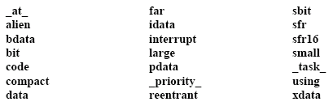
C Extensions: Additional Keywords
For accessing SFRs
Specify where variables go
in memory
Prof. Cherrice Traver
EE/CS-152: Microprocessors and Microcontrollers

Slide 27
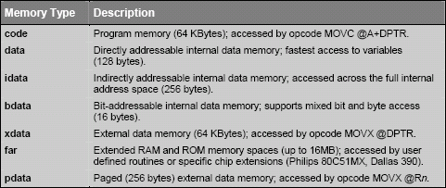
Accessing Specific Memory
Prof. Cherrice Traver
EE/CS-152: Microprocessors and Microcontrollers

Slide 28
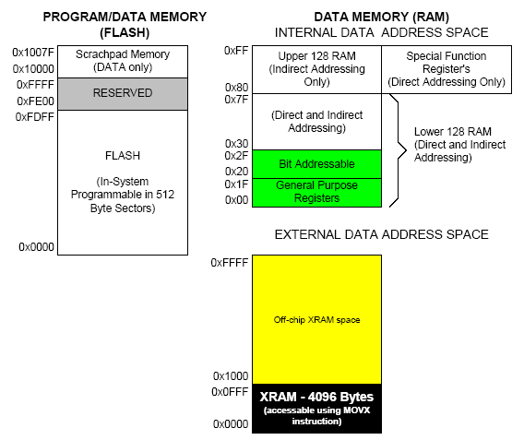
C Access to 8051 Memory
code: program memory accessed by movc @a + dptr
data
bdata
idata
xdata
Prof. Cherrice Traver
EE/CS-152: Microprocessors and Microcontrollers

Slide 29
C Extensions for 8051 (Cygnal)
New data types:
    Example:
  bit bit new_flag; //stored in 20-2F
  sbit sbit LED = P1^6;
  sfr sfr SP = 0x81; //stack pointer
  sfr16 sfr16 DP = 0x82; // data pointer
$INCLUDE (c8051F020.h)
Prof. Cherrice Traver
EE/CS-152: Microprocessors and Microcontrollers

Slide 30
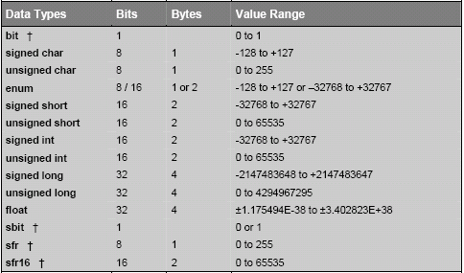
C Data Types With Extensions
Prof. Cherrice Traver
EE/CS-152: Microprocessors and Microcontrollers

Slide 31
Declaring Variables in Memory
char data temp;
char idata varx;
int xdata array[100];
char code text[] = “Enter data”;
Prof. Cherrice Traver
EE/CS-152: Microprocessors and Microcontrollers

Slide 32
Example: Accessing External Memory
Program defines two 256 element arrays in external memory
First array is filled with values that increase by 2 each location.
First array is copied to second array.
Similar to block move exercise done in assembly.
xdata_move.c
Prof. Cherrice Traver
EE/CS-152: Microprocessors and Microcontrollers

Slide 33
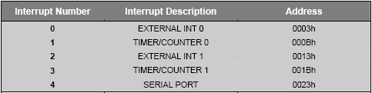
Interrupts – Original 8051
Specify register bank 2
void timer0 (void) interrupt 1 using 2 {
if (++interruptcnt == 4000) { /* count to 4000 */
second++; /* second counter */
interruptcnt = 0; /* clear int counter */
}
}
Prof. Cherrice Traver
EE/CS-152: Microprocessors and Microcontrollers

Slide 34
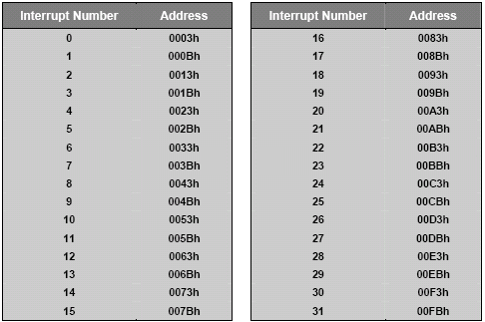
Other Interrupt Numbers
Interrupt number is same as “Priority Order” in datasheet
Prof. Cherrice Traver
EE/CS-152: Microprocessors and Microcontrollers

Slide 35
Revisit Timer Exercise
Blinking!
Prof. Cherrice Traver
EE/CS-152: Microprocessors and Microcontrollers

Slide 36
In-line Assembly
When it is more efficient, or easier, can insert assembly code in C programs.
  #pragma asm
  put your assembly code here
  #pragma endasm
Prof. Cherrice Traver
EE/CS-152: Microprocessors and Microcontrollers

Slide 37
Compilation Process (Keil)
program.c
.OBJ or .SRC can
be generated, not both
compile
no SRC option
with SRC option
program.LST
program.OBJ
program.SRC
build/make
rename file
program.M51
program.asm
build/make
assemble
program.OBJ
Must use this path for C programs with in-line assembly
It is also necessary to add #pragma SRC to code
Prof. Cherrice Traver
EE/CS-152: Microprocessors and Microcontrollers

Slide 38
Example – Switch/LED Program
#include <c8051F020.h>
#pragma SRC // Need this to generate .SRC file
void PORT_Init (void);
char Get_SW(void) {
#pragma ASM
mov a, P3
anl a, #80h ; mask all but P3.7
mov R7, a ; function value (char) returned in R7
#pragma ENDASM
}
void Set_LED(void) {
#pragma ASM
setb P1.6
#pragma ENDASM
}
void Clr_LED(void) {
#pragma ASM
clr P1.6
#pragma ENDASM
}
void PORT_Init (void){ XBR2 = 0x40; // Enable crossbar and enable P1.6 (LED) as push-pull output}
P1MDOUT |= 0x40; // enable P1.6 (LED) as push-pull output
}
void main(void) {
PORT_Init();
while (1)
if (Get_SW()) Set_LED();
else Clr_LED();
}
Functions can be implemented in assembly language
Main function
Prof. Cherrice Traver
EE/CS-152: Microprocessors and Microcontrollers

Slide 39
Interfacing with C
Example: Temperature Sensor program
  Configures the external oscillator
  Configures the ADC0 for temp. sensor
  Configures Port1 so LED can be used
  Configures Timer3 to synch the ADC0
  Uses ADC0 ISR to take temperature samples and averages 256 of them and posts average to global variable
  Main program compares average temp. to room temp. and lights LED if temp is warmer.
  Temp_2.c
Prof. Cherrice Traver
EE/CS-152: Microprocessors and Microcontrollers

Slide 40
Revisit DAC0 Program
And “C” the difference!
Prof. Cherrice Traver
EE/CS-152: Microprocessors and Microcontrollers

Slide 41
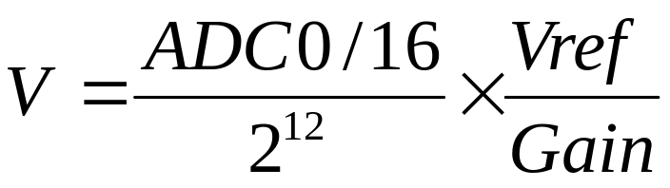
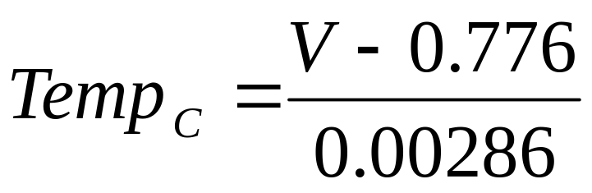
Converting to Real Values
C makes it easier to implement equations
Example: Temperature conversion
For analog to digital conversion – assuming left justified:
The temperature sensor:
Prof. Cherrice Traver
EE/CS-152: Microprocessors and Microcontrollers

Slide 42
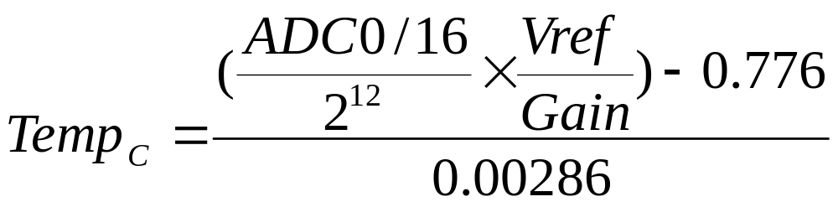
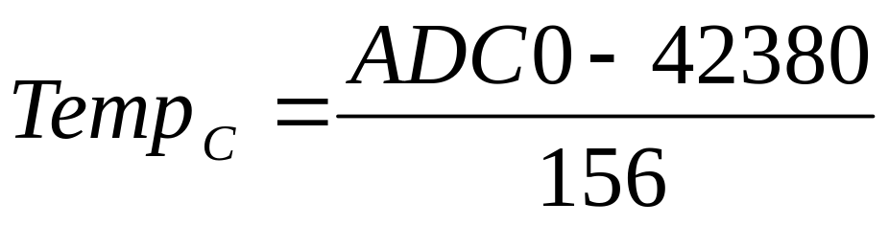
Temperature Conversion
Let Vref = 2.4V, Gain = 2
Prof. Cherrice Traver
EE/CS-152: Microprocessors and Microcontrollers

Slide 43
C for the Equation
…
unsigned int result, temperature;
…
result = ADC0; //read temperature sensor
temperature = result - 42380;
temperature = temperature / 156;
* Must be careful about range of values expected and variable types
Prof. Cherrice Traver
EE/CS-152: Microprocessors and Microcontrollers

Slide 44
Make it REAL!
Temperature Conversion
Prof. Cherrice Traver
EE/CS-152: Microprocessors and Microcontrollers

Slide 45
Initialization
When a C program is compiled, some code is created that runs BEFORE the main program.
This code clears RAM to zero and initializes your variables. Here is a segment of this code:
LJMP 0003h
0003: MOV R0, #7FH
CLR A
back: MOV @R0, A
DJNZ R0, back
...
Prof. Cherrice Traver
EE/CS-152: Microprocessors and Microcontrollers

Slide 46
Arrays in C
Useful for storing data
  type arr_name[dimension]
  char temp_array[256]
  Array elements are stored in adjacent locations in memory.
temp_array[0]
temp_array[1]
temp_array[2]
temp_array[3]
...
temp_array[253]
temp_array[254]
temp_array[255]
Prof. Cherrice Traver
EE/CS-152: Microprocessors and Microcontrollers

Slide 47
Pointers in C
Pointers are variables that hold memory addresses.
Specified using * prefix.
int *pntr; // defines a pointer, pntr
pntr = &var; // assigns address of var to pntr
Prof. Cherrice Traver
EE/CS-152: Microprocessors and Microcontrollers

Slide 48
Pointers and Arrays
Note: the name of an array is a pointer to the first element:
*temp_array is the same as temp_array[0]
So the following are the same:
  n = *temp_array;
  n = temp_array[0];
and these are also the same:
  n = *(temp_array+5);
  n = temp_array[5];
temp_array[0]
temp_array[1]
temp_array[2]
temp_array[3]
…
Prof. Cherrice Traver
EE/CS-152: Microprocessors and Microcontrollers

Slide 49

Arrays
In watch window, address (pointer) of first element array is shown.
Array is not initialized as you specify when you download or reset, but it will be when Main starts.
unsigned char P0_out[4] = {0x01,0x02,0x04,0x08};
Prof. Cherrice Traver
EE/CS-152: Microprocessors and Microcontrollers

Slide 50
Array Example
Prof. Cherrice Traver
EE/CS-152: Microprocessors and Microcontrollers

Slide 51
Compiler Optimization Levels
Optimization level can be set by compiler control directive:
Examples (default is #pragma (8, speed)
  #pragma ot (7)
  #pragma ot (9, size)
  #pragma ot (size) – reduce memory used at the expense of speed.
  #pragma ot (speed) – reduce execution time at the expense of memory.
Prof. Cherrice Traver
EE/CS-152: Microprocessors and Microcontrollers

Slide 52
Compiler Optimization Levels
Level | Optimizations added for that level
0 | Constant Folding: The compiler performs calculations that reduce expressions to numeric constants, where possible.This includes calculations of run-time addresses. Simple Access Optimizing: The compiler optimizes access of internal data and bit addresses in the 8051 system. Jump Optimizing: The compiler always extends jumps to the final target. Jumps to jumps are deleted.
1 | Dead Code Elimination: Unused code fragments and artifacts are eliminated. Jump Negation: Conditional jumps are closely examined to see if they can be streamlined or eliminated by the inversion of the test logic.
2 | ....
3
4
5
6
7
8
9 | Common Block Subroutines: Detects recurring instruction sequences and converts them into subroutines. Cx51 evenrearranges code to obtain larger recurring sequences.
Prof. Cherrice Traver
EE/CS-152: Microprocessors and Microcontrollers

Slide 53
Example: 7-seg Decoder
// Program to convert 0-F into 7-segment equivalents.
#pragma debug code)
#pragma ot (9)
#include <c8051f020.h>
#define NUM_SAMPLES 16
unsigned char SEGS7[16] = {0xC0, 0xF9, 0xA4, 0xB0, 0x99, 0x92, 0x82, 0xF8, 0x80, 0x90, 0x88, 0x83, 0xC6, 0xA1, 0x86, 0x8E};
xdata unsigned char samples[NUM_SAMPLES];
void main (void)
{
char i; // loop counter
WDTCN = 0xde;
WDTCN = 0xad;
for (i=0; i < NUM_SAMPLES; i++)
{samples[i] = SEGS7[i];}
while (1);
}
Prof. Cherrice Traver
EE/CS-152: Microprocessors and Microcontrollers

Slide 54
Effect of Optimization Level on Code Size
Level | Code Size
0 | 53
1 | 53
2 | 53
3 | 51
4 | 46
5 | 46
6 | 39
7 | 39
8 | 38
9 | 38
Prof. Cherrice Traver
EE/CS-152: Microprocessors and Microcontrollers

Slide 55
Level 0 Optimization
; FUNCTION main (BEGIN)
0000 75FFDE MOV WDTCN,#0DEH
0003 75FFAD MOV WDTCN,#0ADH
;---- Variable 'i' assigned to Register 'R7' ----
0006 750000 R MOV i,#00H
0009 C3 CLR C
000A E500 R MOV A,i
000C 6480 XRL A,#080H
000E 9490 SUBB A,#090H
0010 5020 JNC ?C0004
0012 AF00 R MOV R7,i
0014 7400 R MOV A,#LOW SEGS7
0016 2F ADD A,R7
0017 F8 MOV R0,A
0018 E6 MOV A,@R0
…
Prof. Cherrice Traver
EE/CS-152: Microprocessors and Microcontrollers

Slide 56
Level 9 Optimization
; FUNCTION main (BEGIN)
0000 75FFDE MOV WDTCN,#0DEH
0003 75FFAD MOV WDTCN,#0ADH
;---- Variable 'i' assigned to Register 'R7' ----
0006 E4 CLR A
0007 FF MOV R7,A
0008 7400 R MOV A,#LOW SEGS7
000A 2F ADD A,R7
000B F8 MOV R0,A
000C E6 MOV A,@R0
…
Prof. Cherrice Traver
EE/CS-152: Microprocessors and Microcontrollers

Slide 57
Memory Models
Small - places all function variables and local data segments in the internal data memory (RAM) of the 8051 system. This allows very efficient access to data objects (direct and register modes). The address space of the SMALL memory model, however, is limited.
Large - all variables and local data segments of functions and procedures reside (as defined) in the external data memory of the 8051 system. Up to 64 KBytes of external data memory may be accessed. This,however, requires the long and therefore inefficient form of data access through the data pointer (DPTR).
Selected by compiler directives
Examples:
  #pragma small
  #pragma large
Prof. Cherrice Traver
EE/CS-152: Microprocessors and Microcontrollers

Slide 58
Example: LARGE
0006 E4 CLR A
0007 FF MOV R7,A
0008 EF MOV A,R7
0009 FD MOV R5,A
000A 33 RLC A ;multiply by 2
000B 95E0 SUBB A,ACC
000D FC MOV R4,A
000E 7400 R MOV A,#LOW SEGS7
0010 2D ADD A,R5
0011 F582 MOV DPL,A
0013 7400 R MOV A,#HIGH SEGS7
0015 3C ADDC A,R4
0016 F583 MOV DPH,A
0018 E0 MOVX A,@DPTR
….
Registers R4, R5 keep track of 16-bit data address (external RAM)
Prof. Cherrice Traver
EE/CS-152: Microprocessors and Microcontrollers

Slide 59
Example: SMALL
0006 E4 CLR A
0007 FF MOV R7,A
0008 7400 R MOV A,#LOW SEGS7
000A 2F ADD A,R7
000B F8 MOV R0,A
000C E6 MOV A,@R0
….
Data address = #LOW SEGS7 + R7 (8-bit address, RAM)
Prof. Cherrice Traver
EE/CS-152: Microprocessors and Microcontrollers

Slide 60
Initialization
When a C program is compiled, some code is created that runs BEFORE the main program.
This code clears RAM to zero and initializes your variables. Here is a segment of this code:
LJMP 0003h
0003: MOV R0, #7FH
CLR A
back: MOV @R0, A
DJNZ R0, back
...
Prof. Cherrice Traver
EE/CS-152: Microprocessors and Microcontrollers

Slide 61
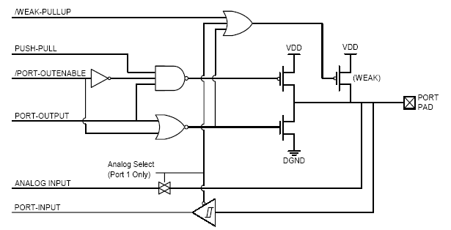
I/O Circuitry - Exercise
Bits accessed via SFRs
Port Bit
(ex: P1.0)
Prof. Cherrice Traver
EE/CS-152: Microprocessors and Microcontrollers

Slide 62
Can be disabled.
By default, inputs are “pulled up” by weak pullup transistor
Therefore, if not connected to anything, inputs are read as “1”.
Prof. Cherrice Traver
EE/CS-152: Microprocessors and Microcontrollers

Slide 63
Port I/O - Output
Output circuit:
Only enabled if /PORT-OUTENABLE = 0
PUSH-PULL = 1 enables P transistor
Non-PUSH-PULL allows wired-or outputs
Prof. Cherrice Traver
EE/CS-152: Microprocessors and Microcontrollers

Slide 64
Port I/O - Input
Port 1 can be configured for either digital or analog inputs using a pass transistor and buffer
Prof. Cherrice Traver
EE/CS-152: Microprocessors and Microcontrollers

Slide 65
Port I/O Example
XBR2 = 0x40; // Enable XBAR2
P0MDOUT = 0x0F; // Outputs on P0 (0-3)
…
P0 = 0x07; // Set pins 2,1,0 and clear pin 3
temp = P0; // Read Port0
Port 0 Latch
I/O Cells
7
6
5
4
3
2
1
0
input pins
output pins
Prof. Cherrice Traver
EE/CS-152: Microprocessors and Microcontrollers

Slide 66
Keypad Interface
Prof. Cherrice Traver
EE/CS-152: Microprocessors and Microcontrollers

Slide 67
C for Large Projects
Use functions to make programs modular
Break project into separate files if the programs get too large
Use header (#include) files to hold definitions used by several programs
Keep main program short and easy to follow
Consider multi-tasking or multi-threaded implementations
Prof. Cherrice Traver
EE/CS-152: Microprocessors and Microcontrollers

Slide 68
Functions
The basis for modular structured programming in C.
return-type function-name(argument declarations)
{
declarations and statements
}
Prof. Cherrice Traver
EE/CS-152: Microprocessors and Microcontrollers

Slide 69
Example – no return value or arguments
void SYSCLK_Init (void) {
// Delay counter
int i;
// Start external oscillator with 22.1184MHz crystal
OSCXCN = 0x67;
// Wait for XTLVLD blanking interval (>1ms)
for (i = 0; i < 256; i++) ;
// Wait for crystal osc. to settle
while (!(OSCXCN & 0x80)) ;
// Select external oscillator as SYSCLK
OSCICN = 0x88;
}
Prof. Cherrice Traver
EE/CS-152: Microprocessors and Microcontrollers

Slide 70
Example – with arguments
void Timer3_Init (int counts) {
// Stop timer, clear TF3, use SYSCLK as timebase
TMR3CN = 0x02;
// Init reload value
TMR3RL = -counts;
// Set to reload immediately
TMR3 = 0xffff;
// Disable interrupts
EIE2 &= ~0x01;
// Start timer
TMR3CN |= 0x04;
}
Prof. Cherrice Traver
EE/CS-152: Microprocessors and Microcontrollers

Slide 71
Example – with return value
char ascii_conv (char num) {
return num + 30;
}
Prof. Cherrice Traver
EE/CS-152: Microprocessors and Microcontrollers

Slide 72
Header Files
Use to define global constants and variables
// 16-bit SFR Definitions for 'F02x
  sfr16 TMR3RL = 0x92; // Timer3 reload value
  sfr16 TMR3 = 0x94; // Timer3 counter
  sfr16 ADC0 = 0xbe; // ADC0 data
  sfr16 DAC0 = 0xd2; // DAC data
  sfr16 DAC1 = 0xd5;
// Global CONSTANTS
  #define SYSCLK 22118400 // SYSCLK frequency in Hz
  sbit LED = P1^6; // LED='1' means ON
  sbit SW1 = P3^7; // SW1='0' means switch pressed
  #define MAX_DAC ((1<<12)-1) // Maximum value of the DAC register 12 bits
  #define MAX_INTEGRAL (1L<<24) // Maximum value of the integral
// Function PROTOTYPES
  void SYSCLK_Init (void);
  void PORT_Init (void);
  void ADC0_Init (void);
  void DAC_Init (void);
  void Timer3_Init (int counts);
  void ADC0_ISR (void);
Prof. Cherrice Traver
EE/CS-152: Microprocessors and Microcontrollers

Slide 73
Multitasking and Multithreading
Multitasking: Perception of multiple tasks being executed simultaneously.
  Usually a feature of an operating system and tasks are separate applications.
  Embedded systems are usually dedicated to one application.
Multithreading: Perception of multiple tasks within a single application being executed.
  Example: Cygnal IDE color codes while echoing characters you type.
Prof. Cherrice Traver
EE/CS-152: Microprocessors and Microcontrollers

Slide 74
Multitasking and Multithreading
A “thread”
void main (void) {
long temperature;
WDTCN = 0xde;
WDTCN = 0xad;
SYSCLK_Init():
PORT_Init ();
Timer3_Init (SYSCLK/SAMPLE_RATE);
AD0EN = 1;
EA = 1;
while (1) {
temperature = result;
if (temperature < 0xB230) LED = 0;
else LED = 1;
}
}
void SYSCLK_Init (void){
int i;
OSCXCN = 0x67;
for (i=0; i < 256; i++) ;
while (!(OSCXCN & 0x80)) ;
OSCICN = 0x88; }
void PORT_Init (void) {
XBR0 = 0x04;
XBR1 = 0x00;
XBR2 = 0x40;
P0MDOUT |= 0x01;
P1MDOUT |= 0x40;}
void Timer3_Init (int counts) {
TMR3CN = 0x02;
TMR3RL = -counts;
TMR3 = 0xffff;
EIE2 &= ~0x01;
TMR3CN |= 0x04; }
Prof. Cherrice Traver
EE/CS-152: Microprocessors and Microcontrollers

Slide 75
Multi-tasking/threading Implementations
Cooperative multi-tasking – each application runs for a short time and then yields control to the next application.
Timer-based multi-tasking – on each timer interrupt, tasks are switched.
When switching between tasks, state of processor (internal registers, flags, etc) must be saved and previous state from last task restored. This is the “overhead” of multitasking. Also called “context switching”.
Prof. Cherrice Traver
EE/CS-152: Microprocessors and Microcontrollers

Slide 76
Multithreading with Interrupts
Interrupt Service Routine
reti
Foreground thread
Main program
Subroutines
ret
Background thread
Interrupt Service Routine
reti
Background thread
Prof. Cherrice Traver
EE/CS-152: Microprocessors and Microcontrollers

Slide 77
Real-Time Operating Systems (RTOS)
Usually a timer-based task switching system that can guarantee a certain response time.
Low level functions implement task switching.
High level functions create and terminate threads or tasks.
Each task might have its own software stack for storing processor state.
Prof. Cherrice Traver
EE/CS-152: Microprocessors and Microcontrollers

